Slide 1





BEST CONSTRUCTION OPC
COMPANY
PROFILE
www.jlcaes.com

Slide 2
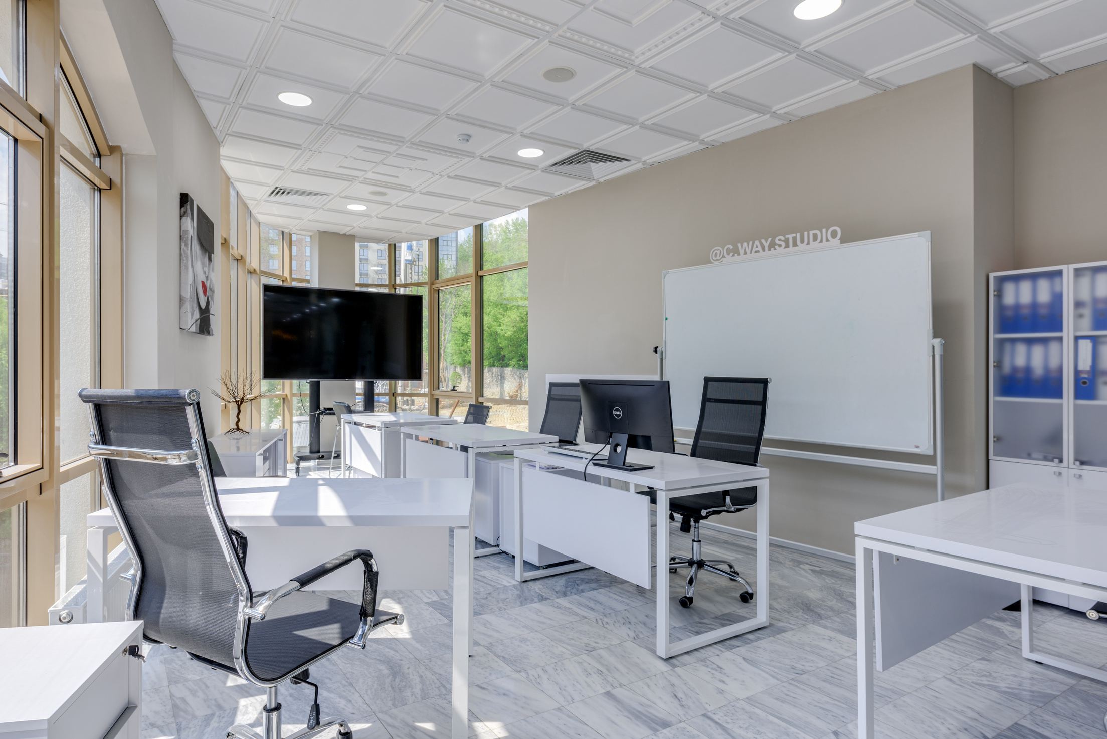

BEST CONSTRUCTION OPC
JLC BEST Construction OPC is a proudly Filipino-owned One Person Corporation dedicated to delivering design-and-build solutions for Mechanical, Electrical, Plumbing, and Sanitary (MEPS) works. Founded by a Professional Electronics Engineer (PECE) with years of industry experience, the company offers integrated construction services, specializing in auxiliary systems including Fire Detection and Alarm Systems (FDAS), Structured Cabling, CCTV, Door Access Control, and Building Automation.
www.jlcaes.com

Slide 3

As the construction arm of JLCAES (JLC Auxiliary Engineering Services), JLC BEST serves as a trusted execution partner in implementing technically-sound and cost-effective engineering designs. The synergy between design and build ensures project consistency, efficiency, and compliance with national codes and international standards.
www.jlcaes.com

Slide 4

JLC BEST Construction is committed to quality, integrity, and innovation, ensuring that each project—whether commercial, industrial, or institutional—is delivered with excellence and aligned with the client’s vision. The company also supports Smart Infrastructure and SCADA integration to future-proof facilities and ensure operational reliability.
Driven by a mission to build with purpose and integrity, JLC BEST Construction OPC continues to grow as a dependable player in the Philippine construction industry.
www.jlcaes.com

Slide 5
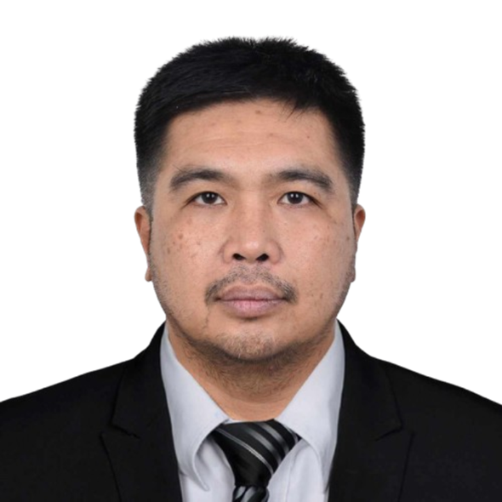
JULIUS L. CALIMAG (JLC)
STATIC POWER PHILIPPINES, INC. (2009 ~ 2025)
Vice President, Shareholder, Authorized Managing Officer (AMO)
PROFESSIONAL ELECTRONICS ENGINEER (2009 ~ Present)
Design and Consultancy of Auxiliary Systems
ASEAN CERTIFIED ENERGY MANAGER (2023 ~ Present)
ASEAN Certified Energy Manager (CEM) for ASEAN Region
ASEAN CHARTERED PROFESSIONAL ENGINEER (2024 ~ Present)
ASEAN Professional Engineer (ACPE) for ASEAN Region
Philippine Integrated Fire Protection Organization (PIFPO) Makati Chapter (2024 ~Present)
Board of Trustee
Brotherhood of Christian Businessmen and Professionals ( BCBP ) Manila (2021 ~ Present)
Governance Team, Family Life Head
Rotary Club Mapua Alumni Manila (2025 ~ Present) Charter Member
FUJITSU TEN SOLUTIONS PHILIPPINES, INC. (1999 ~ 2013)
Established and managed ACE Audio Team for System development Audio for ASEAN market
Quality Assurance, Quality Control, Process Improvement and SCAMPI Leader
Received various Awards including Presidential Awards
Initiated and implemented “Kanban” as Kaizen and became the Best Project and Best Practice

Slide 6
VISION &
MISSION
VISION
By 2035, JLC BEST Construction Opc envisions becoming a top-tier engineering and construction company, known for smart, sustainable, and integrated building solutions. Our goal is to lead the transformation of the industry by integrating IoT-enabled systems, AI-driven engineering designs, and green construction technologies, ensuring that every project we deliver is energy-efficient, disaster-resilient, and adaptable to future innovations.
We aim to expand our impact by collaborating with global industry leaders, investing in renewable energy solutions, and fostering a culture of continuous improvement—building a legacy of innovation, sustainability, and engineering excellence.
www.jlcaes.com

Slide 7
VISION &
MISSION
MISSION
At JLC BEST Construction Opc, our mission is to design, build, and deliver future-ready engineering and construction solutions that seamlessly integrate mechanical, electrical, plumbing, and sanitary (MEPS) systems with advanced auxiliary services. We are committed to providing safe, sustainable, and technologically innovative solutions that meet international standards, ensuring efficiency, durability, and environmental responsibility.
By 2030, we aim to be a recognized leader in design-build solutions, setting benchmarks for quality, reliability, and smart engineering practices in the construction industry. Through continuous professional development, strategic partnerships, and cutting-edge technology, we strive to empower businesses, industries, and communities with infrastructures that stand the test of time.
www.jlcaes.com

Slide 8
AUXILIARY DESIGN & BUILD
Fire Detection and Alarm System (FDAS)
Telephone and Data System
Fiber to the Home (FTTH)
Fiber to the Antenna (FTTA)
Fiber to the Node (FTTN)
Fiber to the Building (FTTB)
Structured Cabling
CATV System/MATV System
Paging and Background Music System (PABM)
Nurse Call System
Security System
Panic Alarm System
Door Monitoring
Watchman Tour System
CCTV Surveillance System
Intercom
Accelerograph System
Wireless Data System (PICOCELL)
WI-FI SYSTEM
Building Automation System (BAS) / Building Monitoring System (BMS)
SCADA (Automation)

Slide 9
ENGINEERING DESIGN & BUILD
( in partnership with established MEPFS consultants and contractors)
Electrical
Electrical Interior and Exterior Lighting Design
Power and System Design
Industrial building design and engineering
Mechanical
Air Conditioning and Ventilation Systems
Generator Set System Design
Water Supply Distribution System
Sanitary and Storm Drainage System
Fire Protection System
Gas / Piping System

Slide 10
ENGINEERING AUDIT
Fire Detection and Alarm System (FDAS)
Electrical Power and System
Mechanical
Structural
Energy
TESTING AND COMMISSIONING
Fire Detection and Alarm System (FDAS)
Electrical Power and System
Mechanical
Structural
Energy
Plumbing and Sanitary

Slide 11
OTHER ENGINEERING SERVICE
Value Engineering
Project Management
Consultancy
www.jlcaes.com

Slide 12

KEY SERVICE OFFERINGS (HOSPITALS)
Design and Build Projects (MEPF)
Auxiliary Systems (FDAS, CCTV, Access Control, etc)
Smart Power Solutions (Generator Sets, SCADA, Solar PV, ATS, Smart Metering)
Enterprise Resource Planning (ERP)
Cybersecurity for Healthcare
www.jlcaes.com

Slide 13
WHY JLC BEST CONSTRUCTION OPC
PECE-Led Expertise
Agile Execution
Smart Hybrid Solutions
Compliance with Philippines Codes and Standards
IT and Cybersecurity
www.jlcaes.com

Slide 14





























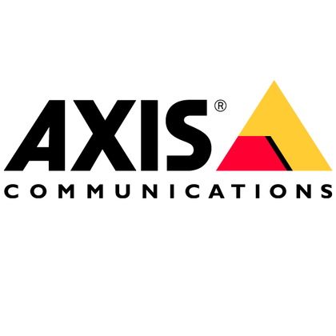








KEY PRODUCTS
www.jlcaes.com

Slide 15

AGILE EUROPE: HYBRID SOLUTION
Significant fuel savings - Prioritizing renewable energy in a solar abundant regime the system significantly cuts down fuel consumption and refueling and fuel transportation costs, leading to lower operational expenses.
Resilience to fuel price volatility – By minimizing dependency on fossil fuels, hybrid systems can shield operations from fluctuations in fuel prices.
Enhanced Energy Independence - Local energy generation, reducing reliance on imported fuel and increasing energy sovereignty.
Improved Power Quality - Stable voltage and frequency control can be beneficial for sensitive equipment and industrial applications.
Increase Genset Lifespan - By using renewables as the primary source, the load and operating time on backup generators are minimized, prolonging their operational lifespan. ssions and promoting cleaner energy practices.
6. Reduced Maintenance - With fewer moving parts in renewable systems compared to traditional generators, overall maintenance demands are lower, translating to less downtime and reduced costs.
7. Sustainability - Supports long-term energy goals by reducing greenhouse gas emissions and promoting cleaner energy practices.

Slide 16
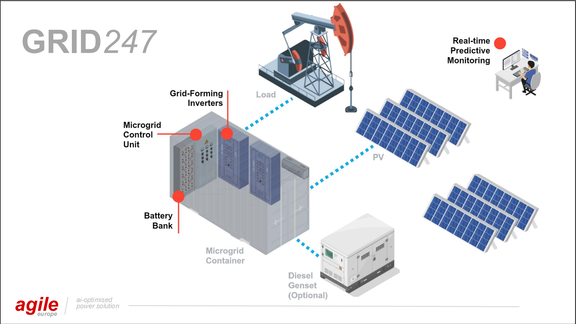
AGILE EUROPE: HYBRID SOLUTION

Slide 17
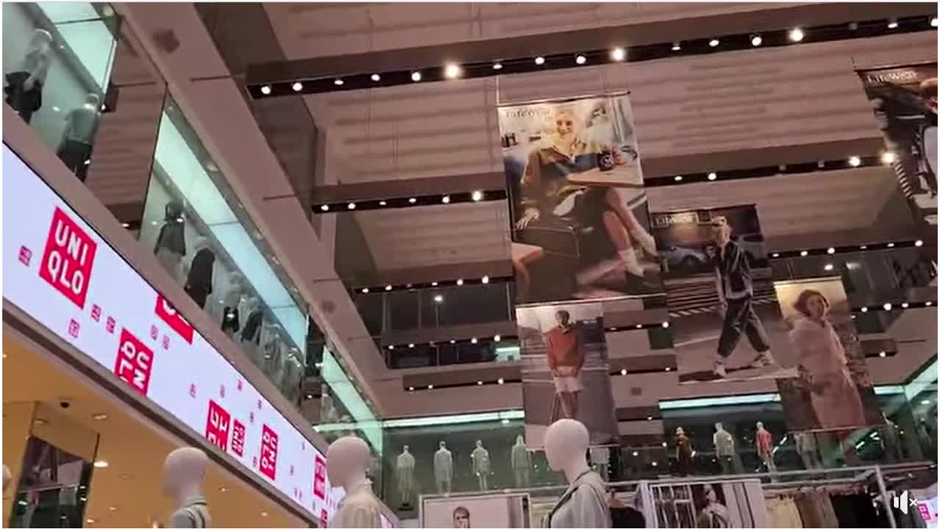
PAST AND ONGOING PROJECTS
Installation of Auxiliary Devices for Cyberpark Tower 3
Installation of Auxiliary Devices for Evo Tower 1 and Tower 2
Supply and Installation of FTTH of Cebu Cyberzone Mixed Use Tower 3 and Tower
Manpower Assistance for Multi-skilled Technician for Jones Lang Lasalle (JLL)
Uniqlo Glorietta 5 Manequin automation
Various Auxiliary Design projects

Slide 18
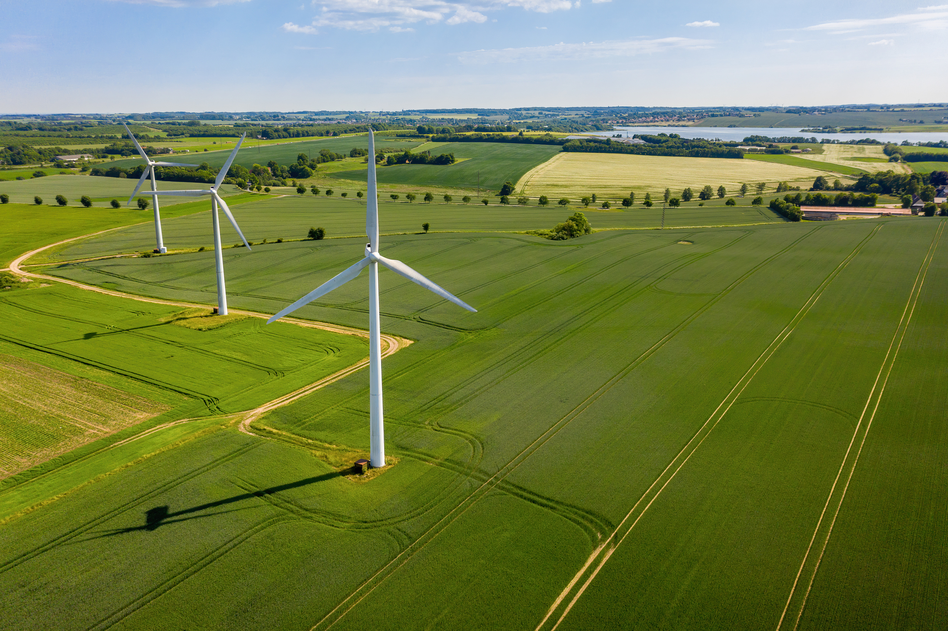
PAST AND ONGOING PROJECTS
7. Sitangkai, Tawi tawi (650kw)
hybrid, 4 x genset, BESS, solar
8. Sibutu, Tawi tawi (650kw)
hybrid, 3 x genset, BESS, solar
9. Toyota, Laguna
Zero Export
10. Suweco Marinawa, Catanduanes (15MW)
SCADA ( 14 x gensets)
11. Suweco Carabao Island (3MW)
SCADA (3 x gensets)
12. Suweco Odiongan, Romblon (14MW)
SCADA (14 x gensets)
13. Suweco San Agustin, Romblon (4MW)
SCADA (4 x gensets)
14. Uniqlo Manequin Project (JLC BEST)
SCADA using Siemens

Slide 19
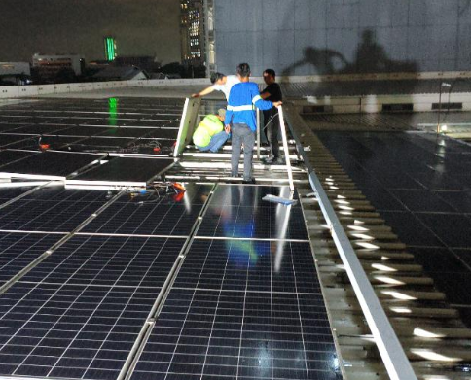
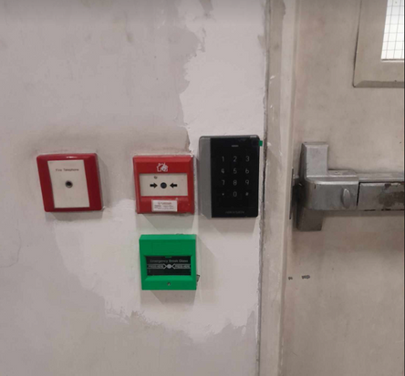
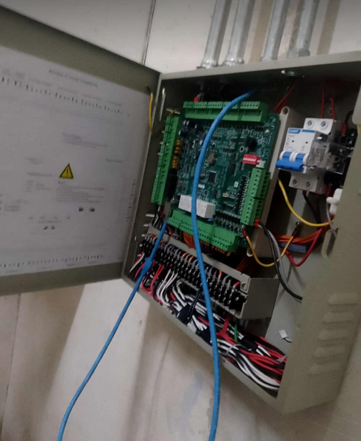
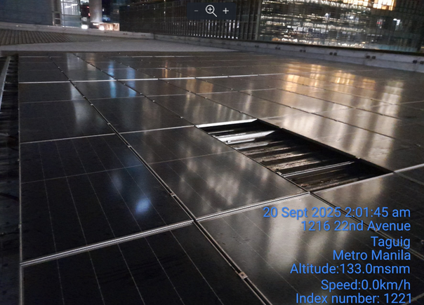
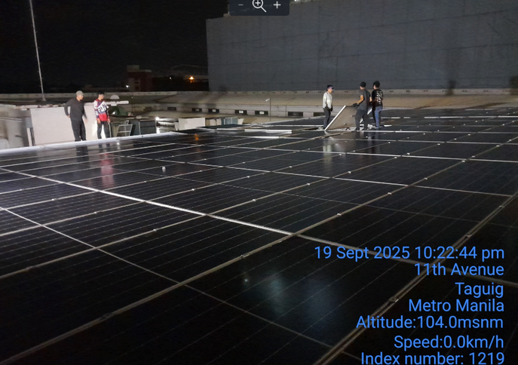
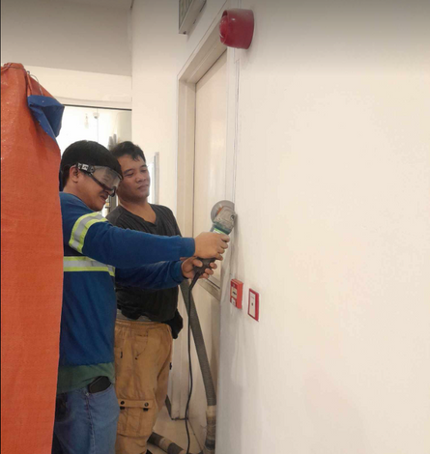
PAST AND ONGOING PROJECTS
15. Maridien Tower -Bonifacio Global City (BGC)
Installation of Fire Detection and Alarm
System (FDAS) and Door Access Control
System
16. Toyota Global City Inc. -Bonifacio Global
City (BGC)
Dismantling and Re-installation of PV
Panels and Replacement of Rapid
Shutdown Devices

Slide 20
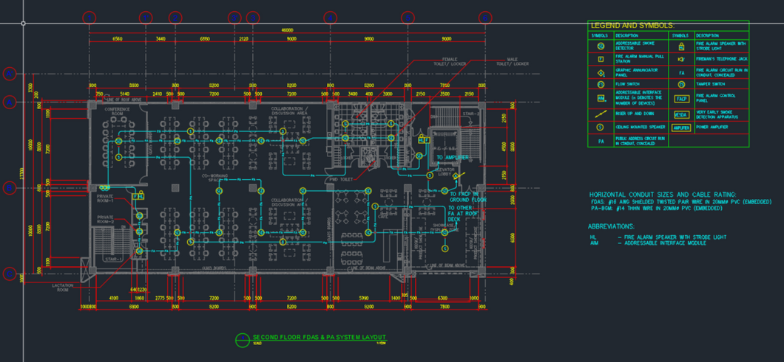
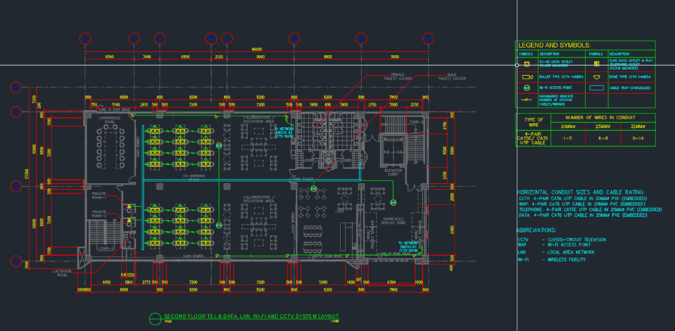
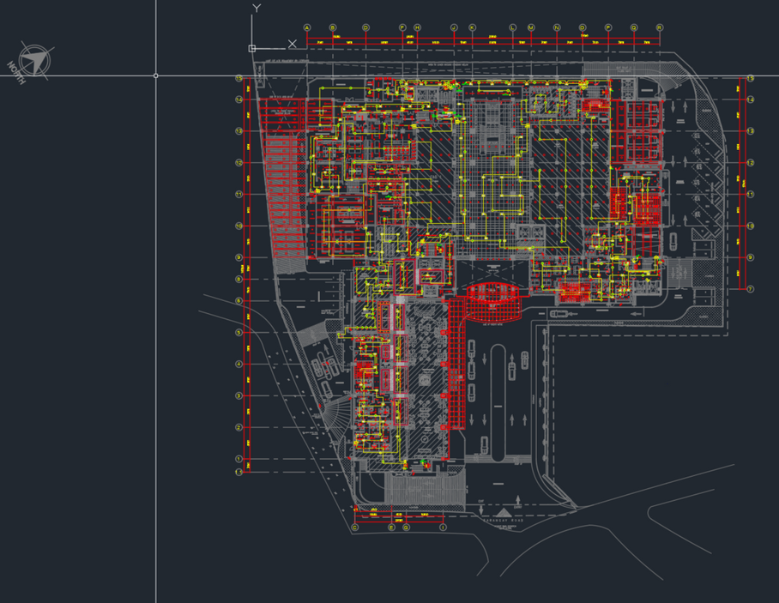
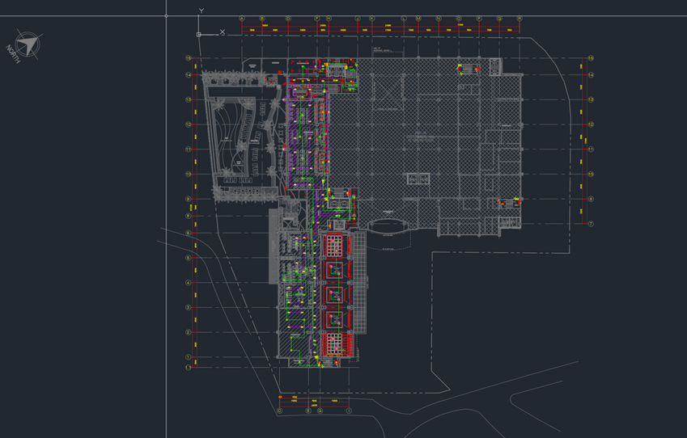
DESIGN AND CONSULTANCY
1. TESDA PILI - Pili, Camarines Sur
Auxiliary Design Consultancy for Technical Education and Skills Development Authority (TESDA)
2. TESDA BANGUI - Bangui, Ilocos Norte
Auxiliary Design Consultancy for Technical Education and Skills Development Authority (TESDA)
3. TESDA BAGUIO - Baguio City
Auxiliary Design Consultancy for Technical Education and Skills Development Authority (TESDA)
4. TESDA DAVAO - Davao Oriental
Auxiliary Design Consultancy for Technical Education and Skills Development Authority (TESDA)
5. BORACAY HOTEL AND CASINO
Auxiliary Design Consultancy
6. QUALIMED NUVALI (MDC)
Auxiliary Design Consultancy
7. QUALIMED ALTARAZA (MDC)
Auxiliary Design Consultancy
8. ST. LUKE’S MEDICAL CENTER EXTENSION CLINIC
Auxiliary Design Consultancy

Slide 21
DESIGN AND CONSULTANCY
9. Saint Marcel Residences (Megaworld) -San Fernando,
Pampanga
Auxiliary Design Consultancy
10. Laya (Shangrila Properties) - Pasig City
Auxiliary Design Consultancy
11. Shang Summit (Shangrila Properties) - Quezon City
Auxiliary Design Consultancy
12. Scala (Vista Estates) - Taguig City
Auxiliary Design Consultancy
13. RLC Residence (Robinsons Land) - Mandaluyong City
Auxiliary Design Consultancy
14. Midpark Towers - Parañaque City
Auxiliary Design Consultancy
15. Eastbay Residences: Fordham Tower - Sucat,
Muntinlupa
Auxiliary Design Consultancy
16. FEU Alabang Phase 2 - Muntinlupa City
Auxiliary Design Consultancy

Slide 22


HEALTHCARE CYBERSECURITY
Advanges of Healthcare Cybersecurity:
Data Protection
Patient Trust and Privacy
Regulatory Compliance
System Reliability
Improved Collaboration
Reduced Financial and Reputational Risk
Support for Innovation
Prevention of Medical Fraud
Disadvanges of Healthcare Cybersecurity:
Costs and Complexity
- Significant Investment
- System Complexity
Operational Disruption
- User Inconvenience
- Delayed Care

Slide 23
HEALTHCARE CYBERSECURITY
Disadvanges of Healthcare Cybersecurity:
Human Factors and Skill Gaps
- Human Error
- Skill Shortages
Data Vulnerabilities
- Centralized Data Risks
- Third-Party and Devices Risks
Evolving Threats
- Constantly Changing Landscape
- Inadequate Response

Slide 24
THANK
YOU
JLC BEST Construction OPC
Contact: Julius L. Calimag, PECE
📧 jlcaengineeringserv@gmail.com
📞 +63 917 501 4376
🌐 www.jlcaes.com

